Slide 1
Understanding the three branches of State
Key Stage 2

Slide 2
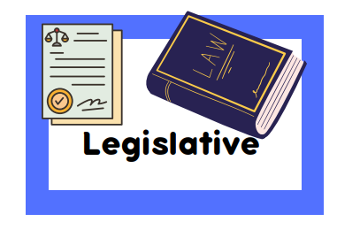
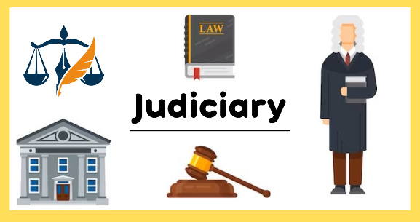
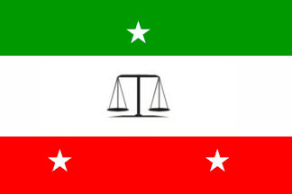
Notes:
Prompt questions to explore
Ask them what they understand the word “power”

Slide 3
Who are the people in the 3 branches of State?
The three branches of State
Legislature
Executive
Judiciary
Notes:
Explain to them the people who are involved in governing these branches.
Legislature: for example; speaker of the Majlis, deputy speaker, parliament members, sergeant of arms,
Executive: president, cabinet members
Judiciary : chief of the justice, lawyers, judges

Slide 4
Separation of Powers
The State
Legislature
Executive
Judiciary
Legislative authority of Maldives is the People’s Majlis
The President of Maldives is the head of state, the government, and the Commander in Chief of the Armed Forces.
Judicial power is vested in the Supreme Court, the High Courts and trial courts
Notes:
Legislature approves law, amend the constitution debate bills, represent people
Executive“: select the cabinet, execute the policies
Judiciary :implement laws
The Supreme Court is the highest authority for the administration of justice in the Maldives.

Slide 5
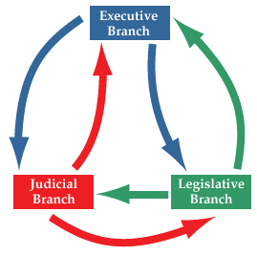
Why is separation of powers important??
It provides a system of checks and balances; each branch checks the exercise of power by the other branch so no one can abuse their powers

Slide 6
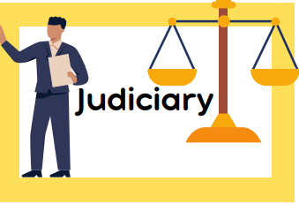
Activity
Branches of State Match Madness

